Slide 1
ATM Simulation System
Ahmed Ibrahim
&
Md Sahid Hossain
&
Shiqi Pang

Slide 2
Statement
The ATM System allows users to perform essential banking operations securely and efficiently. Users can log in to the system to check their account balance, withdraw cash, deposit funds, transfer money between accounts, and change their personal identification number (PIN). The system ensures these actions are processed in real-time.
Administrators have additional control over the system, including the ability to add or delete users and review transaction histories. The system supports both routine user transactions and administrative tasks, ensuring seamless financial management for all parties involved.

Slide 3
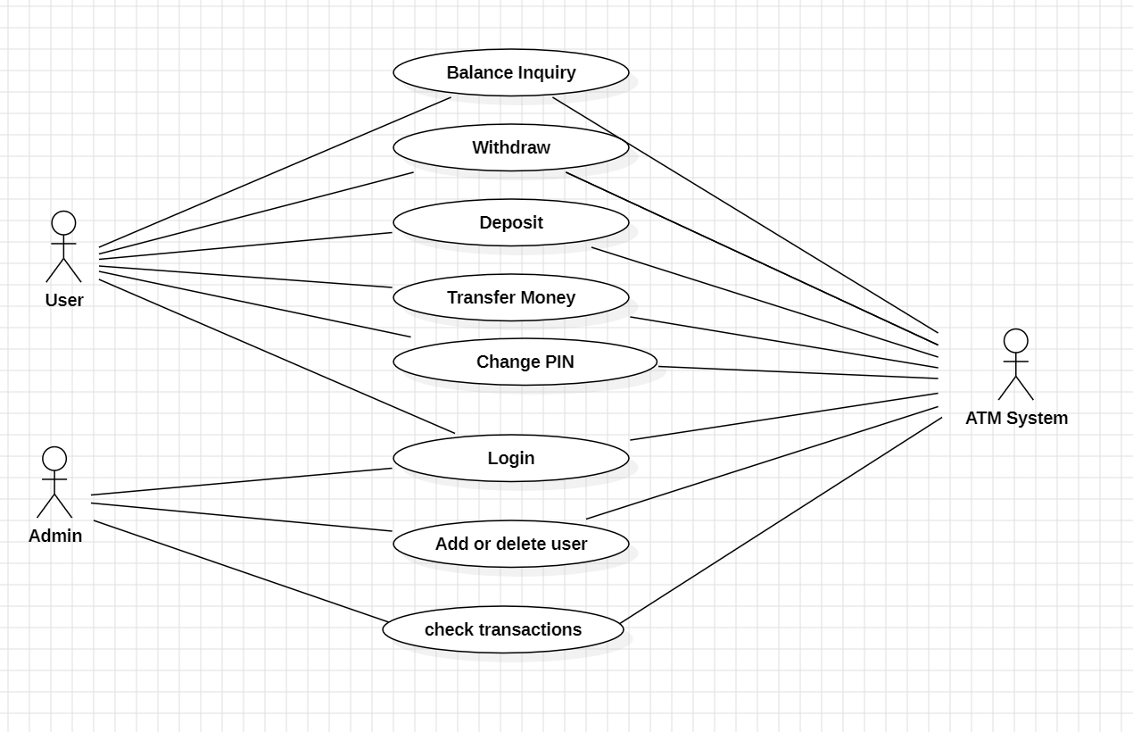
Use Case

Slide 4
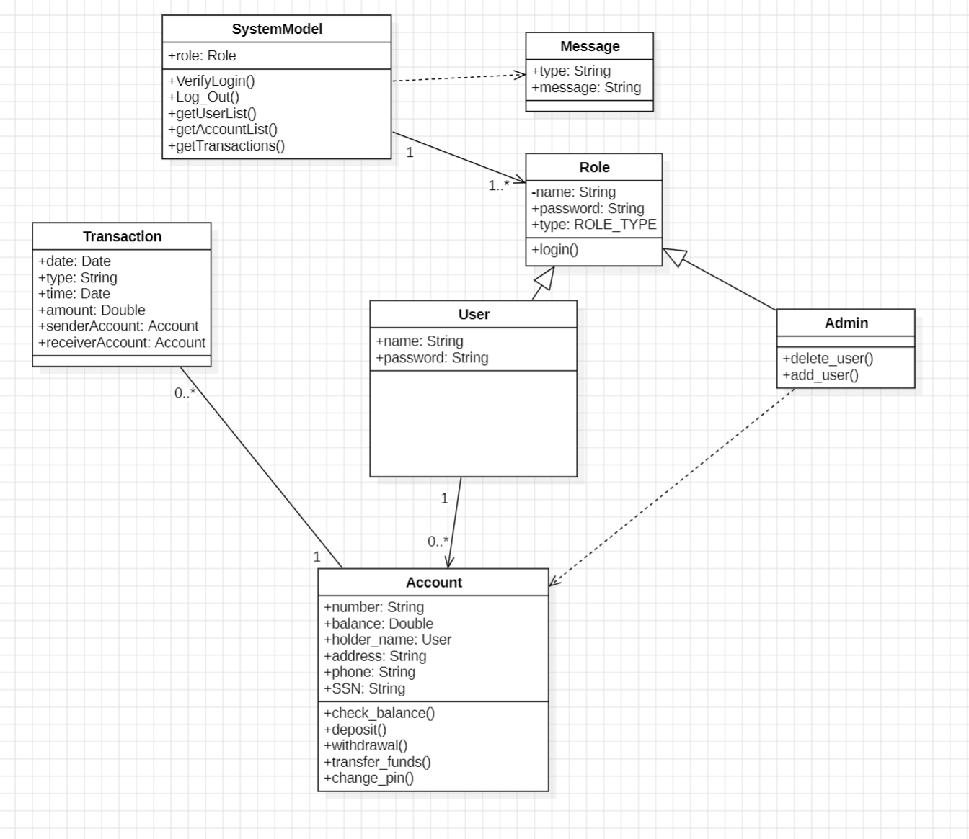
Class Diagram

Slide 5
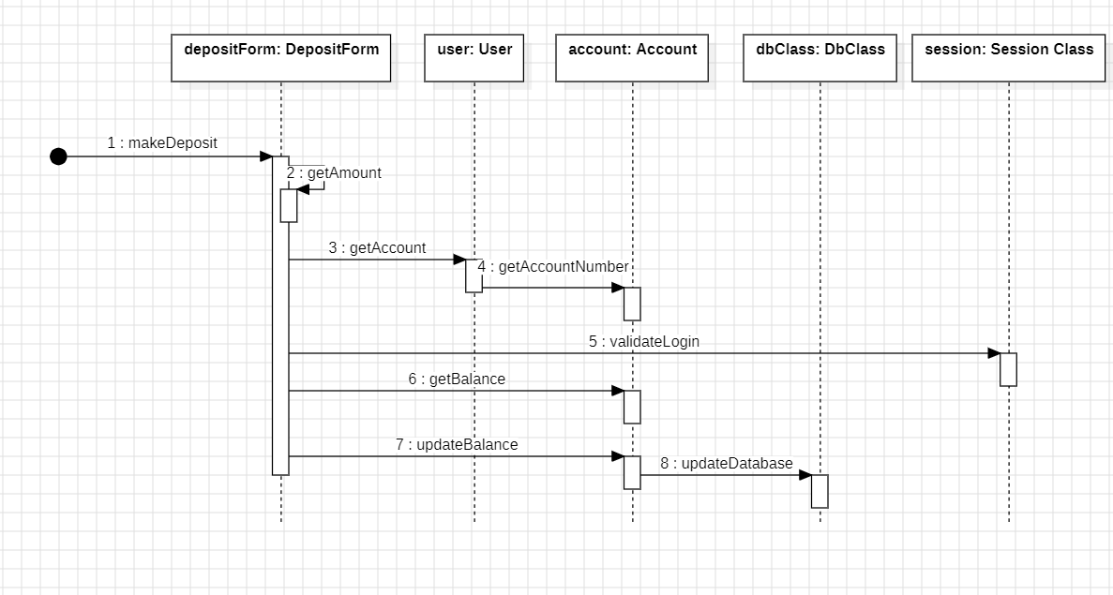
Deposit Sequence Diagram

Slide 6
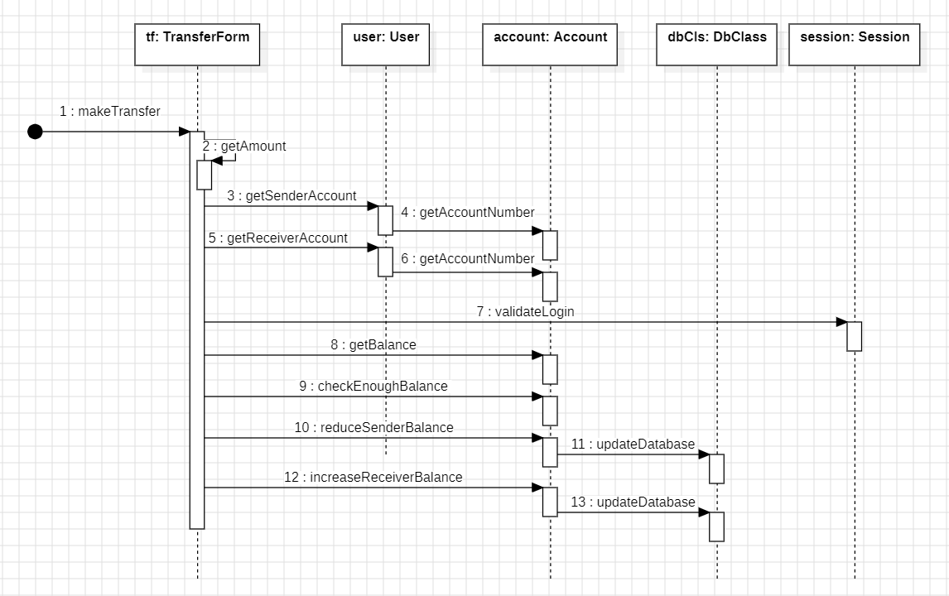
Transfer Sequence Diagram

Slide 7
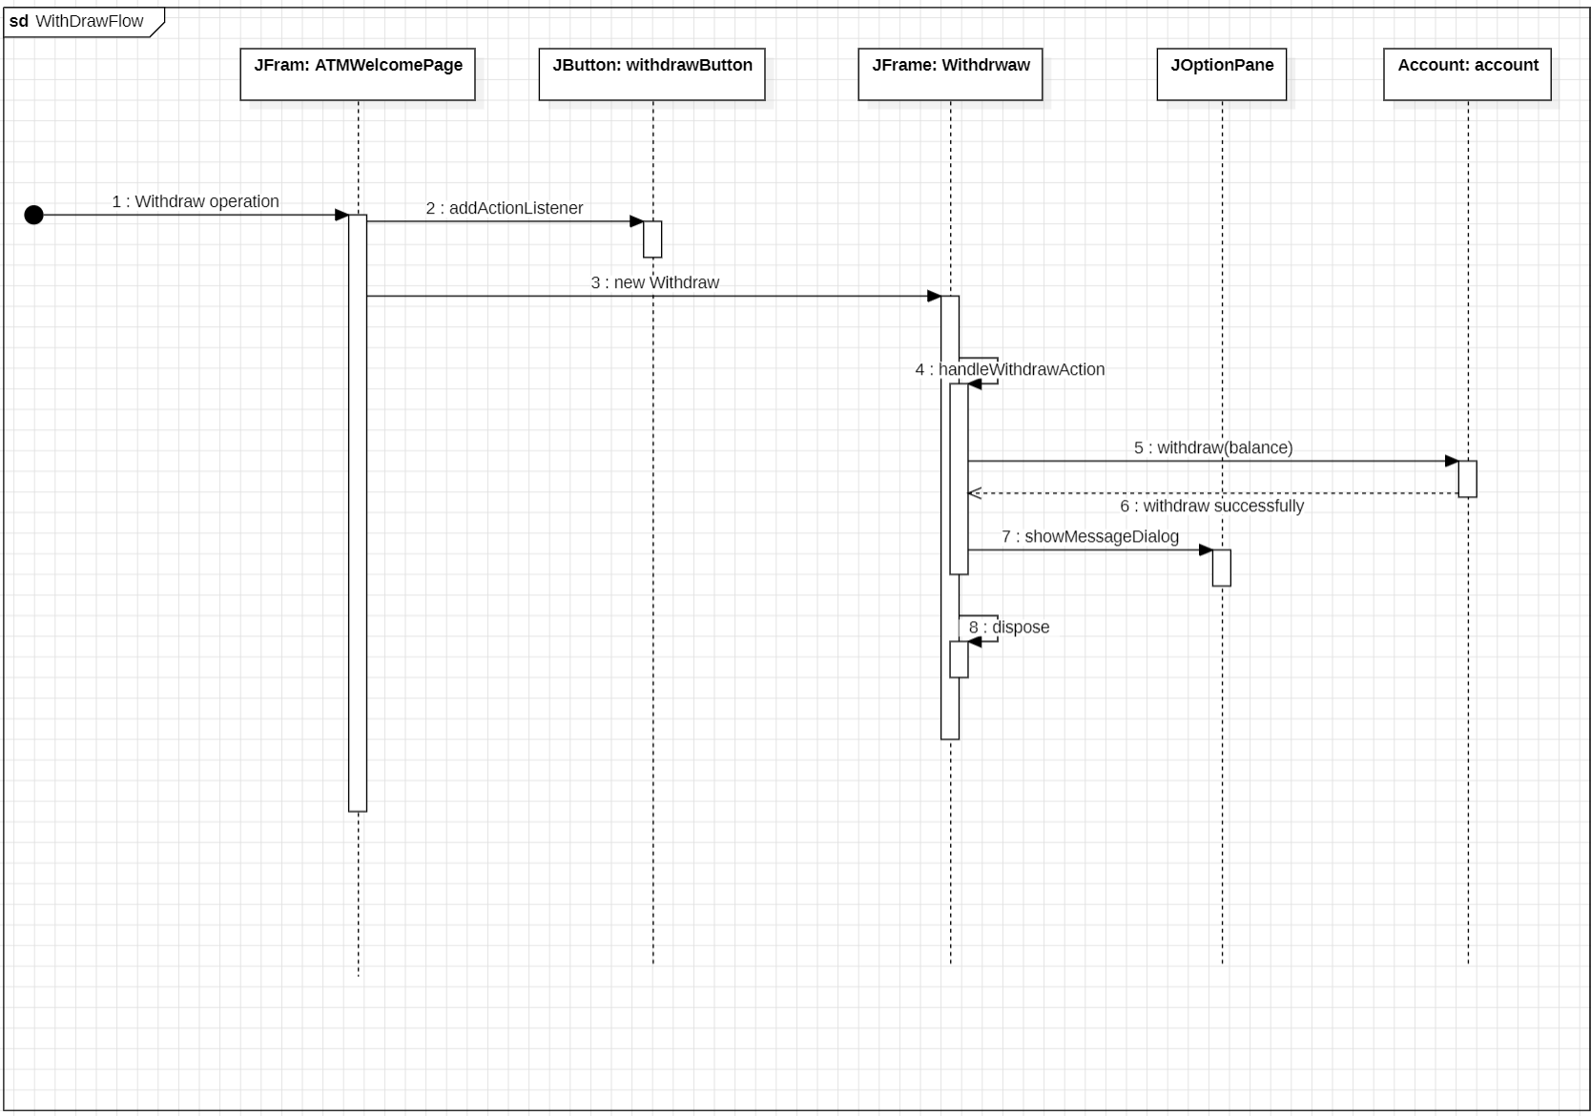
Withdraw Sequence Diagram

Slide 8
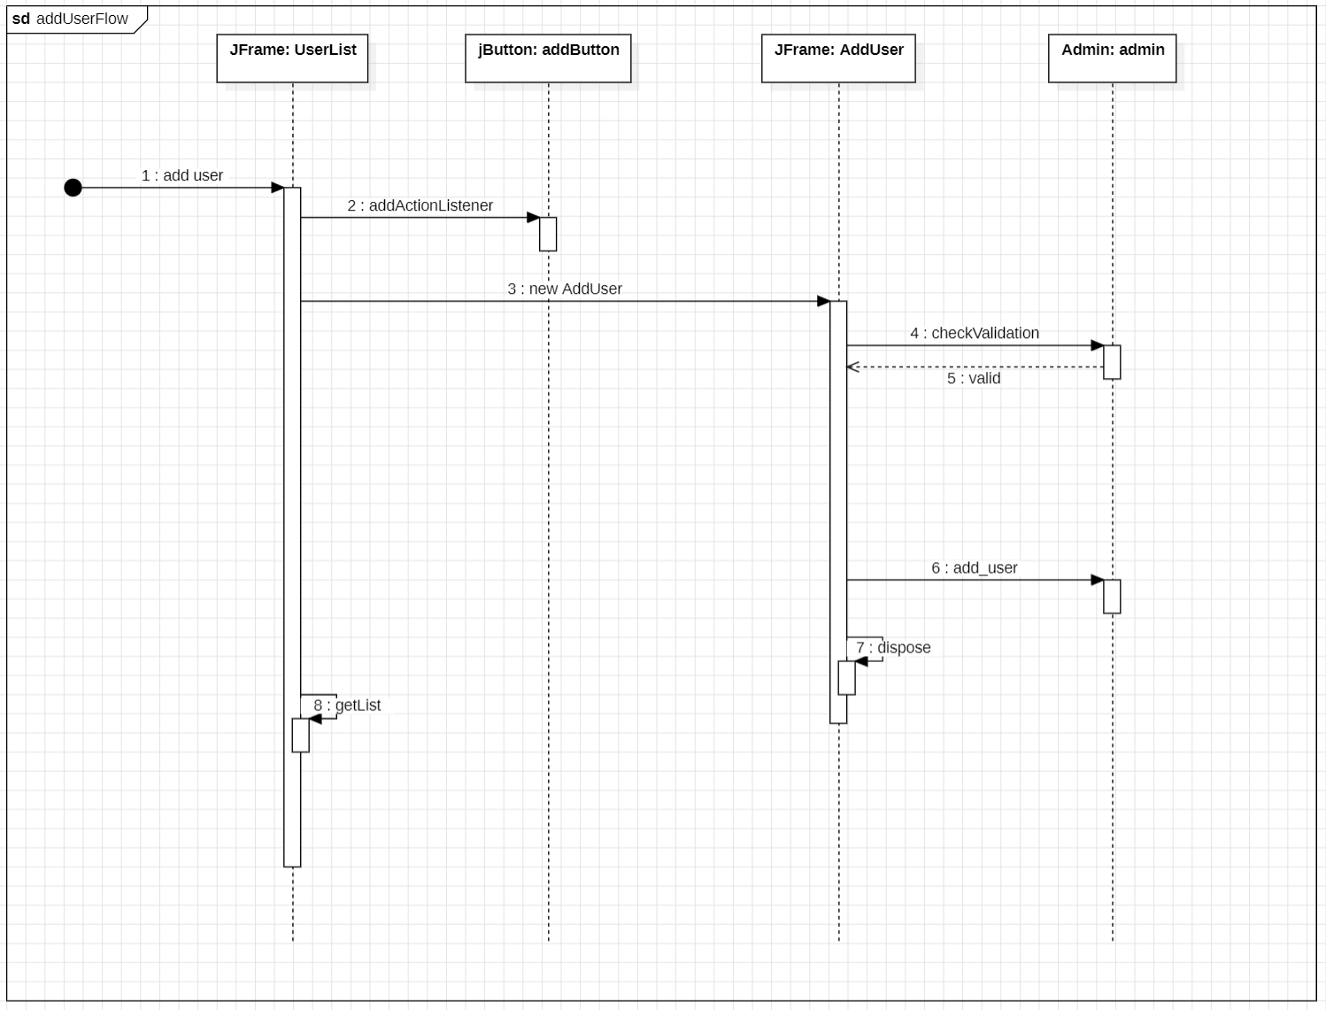
Add User Sequence Diagram

Slide 9
Validation Checks
We ensured validation for the following:
If the user is logged in.
Whether the logged in user is of type customer or admin.
If the user has a valid account.
If there is sufficient amount of money to withdraw or transfer.

Slide 10
Main Point
Modular Design and Reusability: By structuring the system with separate functionalities like login, balance inquiry, and money transfer, we adhered to the Modularity principle of STC. This ensures that each module is responsible for a distinct function, making the system more maintainable and reusable. For instance, the Login and Transaction modules can be reused or extended without affecting other parts of the system. The Java language’s object-oriented features, such as encapsulation and inheritance, were key in implementing this modularity.
User Interface Design and Event Handling: Using Java Swing for the user interface design allowed us to apply STC's Human-Computer Interaction (HCI) principles. We focused on creating a simple and intuitive user interface, where users can easily interact with the ATM functionalities. Event handling in Java Swing enabled real-time response to user actions, enhancing system interactivity. The clear separation of the graphical interface from the core logic adheres to Separation of Concerns, another key STC concept, making the system more scalable and easier to debug.

Slide 11
Thank you

